Slide 1

Project given by :

Slide 2

My digital marketing internship at Flying Machine Company was an eye-opening experience
that exposed me to the intricacies of marketing in the real world. Working closely with the
team, I was able to contribute to various campaigns and initiatives, gaining hands-on
experience in digital marketing strategies, analytics, and customer engagement.
I would also like to express my sincere appreciation to the college director, principal, and
Head of the Department for providing me with the opportunity to undertake these
internships as part of my academic curriculum. Your commitment to fostering practical
learning experiences has greatly enriched my education.
I would also like to express my sincere appreciation to my team members for their
unwavering support during my internship. Their encouragement, and willingness to share their
expertise have been instrumental in my growth as a digital marketing professional.
Once again, thank you for the support and guidance that have made these internships a
reality. I look forward to your feedback and am open to any further recommendations or
suggestions for my future endeavors.

Slide 3

TEAM MEMBERS
Team lead : Podila Pravallika
Team member : Shaik Anwar basha
Team member : Shaik Muzavar Abdul Samad
Team member : Gopidesi Venkatesh
Team member : Naraboina Rajesh

Slide 4

Brand study, Competitor Analysis &
Buyer’s/Audience’s Personal
 Flying Machine is an Indian denim and casual wear brand owned
by Arvind Limited. It was launched in 1980 and has since become a
prominent name in the Indian fashion industry. Here's a brief analysis
of the Flying Machine clothes brand:
 *Market Positioning:* Flying Machine is positioned as a youth-
oriented brand that offers trendy and fashionable denim and
casual wear. It's known for its edgy and contemporary designs,
appealing to the younger demographic.

Slide 5
Analysis:
 *Target Audience:* The brand primarily targets the urban youth
and young adults who are fashion-conscious and value style and
individuality. Its designs cater to those who want to make a
statement with their clothing choices.
 Product Range:* Flying Machine offers a wide range of products
including jeans, shirts, t-shirts, jackets, and accessories. Its focus on
denim products has helped it carve a niche in the Indian fashion
market.

Slide 6

Collaborations:
Flying Machine has collaborated with various celebrities and
influencers to enhance its brand image and appeal to its target
audience.

Slide 7
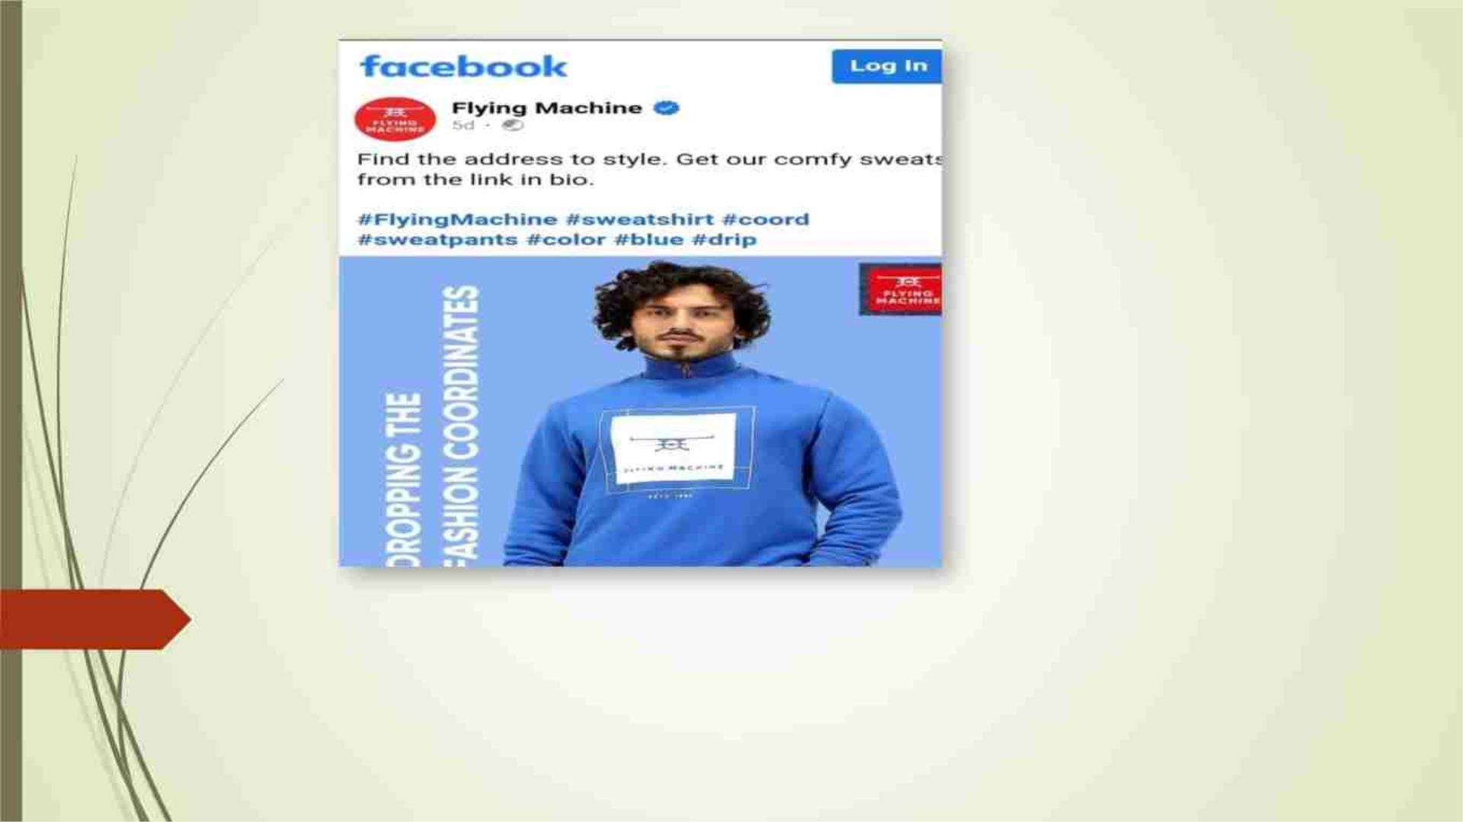
*Social Media:*
The brand is active on social media platforms, connecting with its
target audience through engaging content and influencer
partnerships.

Slide 8
History of Flying Machine:
 Flying Machine is one of the indigenously grown brands started by
garment division of Arvind mills. The brand was incepted in 80’s;
Flying Machine is among few early brands which started the denim
category in India though consumption was pretty low. The brand
had the positioning of ‘guaranteed brand’ due to its unique pricing
and product innovation. However, with the growing penetration of
online retail and multiple retail channels, the brand started
experiencing operational huddle in managing inventory as it goes
on multiple channels.

Slide 9
Progress:
 Since integrating with the Rubicon platform, Flying Machine has
increased its online visibility, strengthened its marketplace business
and grown its sales quite significantly. Moreover, the platform
allowed Flying Machine to showcase all their categories and reach
out to newer marketplaces and significantly increase their sell-
throughs.
 Following are the few impacts that Rubicon enabled for Flying
Machine from Q1 17-18 to Q4 17-18.
 23 times rise in GMV
 22 times rise in orders across marketplaces
 Fulfilment rate increased to 98.99%
 Sell through increased by 25%

Slide 10
Flying Machine India Company Profile
• Company Full Name: Arvind Limited
• Type: Private
• Industry: Fashion wear
• Founded Year: 1980
• Founder: NA
• Headquarters: Naroda, Ahmedabad, Gujarat, India
• Key People: Mr. Sanjay Lalbha (CEO & MD)
• Parent Company: Lalbhai Group
• Subsidiaries: NA

Slide 11
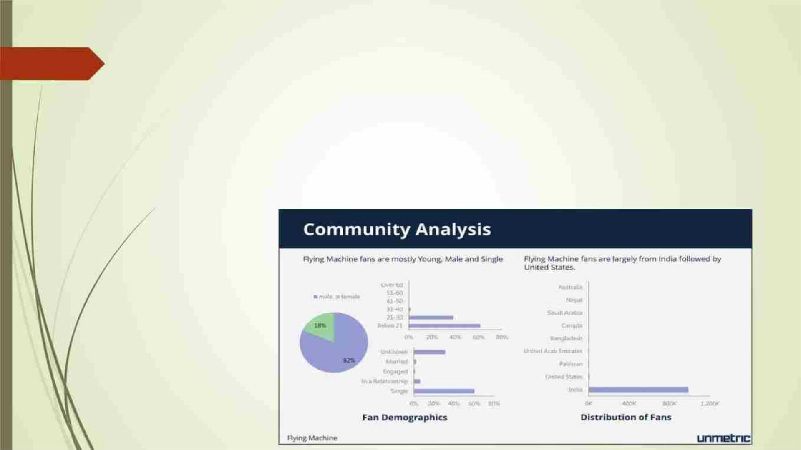
SEO & Keyword Research:
 An SEO audit is a comprehensive evaluation of a website's search
engine optimization (SEO) performance and overall health. The
main purpose of an SEO audit is to identify areas of improvement
and uncover issues that may be hindering the website's ability to
rank well in search engine results. The SEO audit for lakme is as
follows:

Slide 12

Rankings of keywords:
Keyword rankings refer to the positions that specific keywords or key phrases hold
in the search engine results pages (serps) when users search for those terms.
#3 Denim Brand in the country.
• India's first homegrown denim brand and one of the coolest youth
apparel brands in the country with a play in denims, tees and casual shirts
• Well defined categories with Innovative jeans wear in FM, Entry price
point heavy in FMX range & Urban play for digital natives in FM2001
• FMX Model stores for small tier towns of India, and strategic partnership
with Flipkart group to strengthen its innovative, online first mindset
• Size : ~400+ Cr NSV turnover
• Revenue CAGR# : 18%
• Store Count : 250+

Slide 13
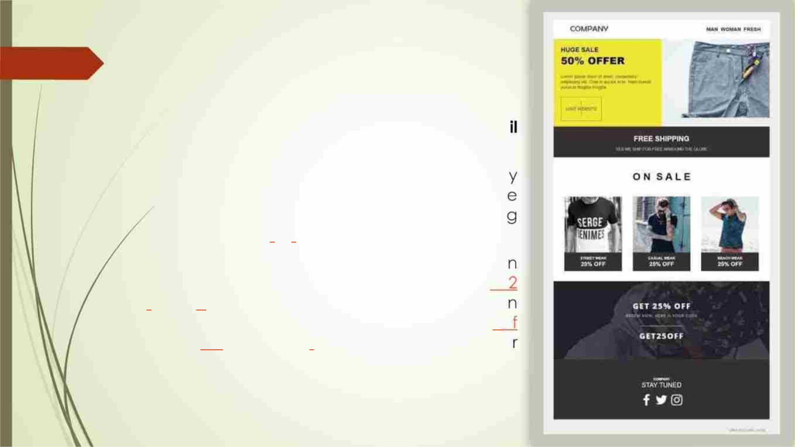
Email Marketing:
 Flying Machine
ID: care@nnnow.com
Head
Office
Ema
 Retail brands like fashion stores have an industr
average open rate of 18.39% and an averag
click rate of 2.25% for their marketin
emails, according to Mailchimp.
 There’s a reason the average return o
investment for email marketing is still $4
for every dollar. It’s simple yet so effective. I
total, email marketing is responsible for 81% o
customer acquisition and 80% of custome
retention.

Slide 14
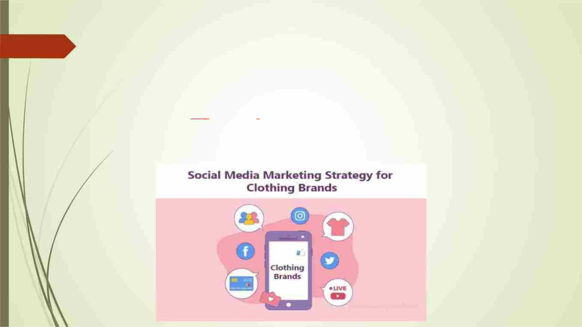
Social Media Marketing:
In addition to managing your social media accounts, influencer marketing should be
an essential part of your overall strategy. Influencer marketing budgets are increasing
year-over-year, with 17 percent of companies planning to spend more than half of
their budget on this marketing method. There are several ways you can work with
influencers to increase sales and spread brand awareness.

Slide 15
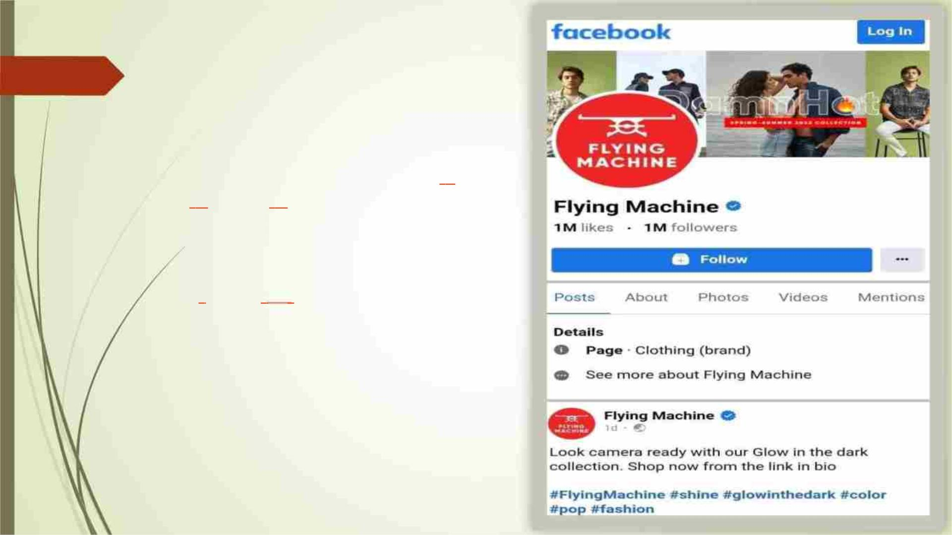
Facebook
Facebook is the most used social media
platform in the world with 2.45 billion
monthly active users. In addition to
regular Facebook posts, fashion app
marketers can use the platform for live
broadcasts. For example, ASOS went live
with ‘100 layers of ASOS,’ a short contest
between ASOS staff members where
they had 30 minutes to create a look for
their models – using 100 layers for ASOS
clothing dramatic effect.

Slide 16
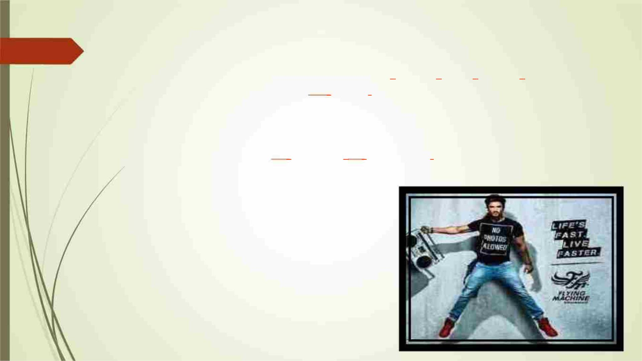
Instagram:
Instagram has an active global audience of 500 million daily active users, collectively
tapping the platform’s “Like” button 4.2 billion times every day. Ecommerce merchants
can also use Instagram’s shopping feature, allowing users to purchase items without
leaving the app. Instagram offers several ways to connect with your audience,
including Posts, Reels, Stories, Highlights and IGTV. Instagram is synonymous with social
media fashion influencers and 69 percent of marketers plan to spend more money on
Instagram influencers than any other market this year.
Link :
https://instagram.com/flyingmachine80?igshid=
MmU2YjMzNjRlOQ==

Slide 17
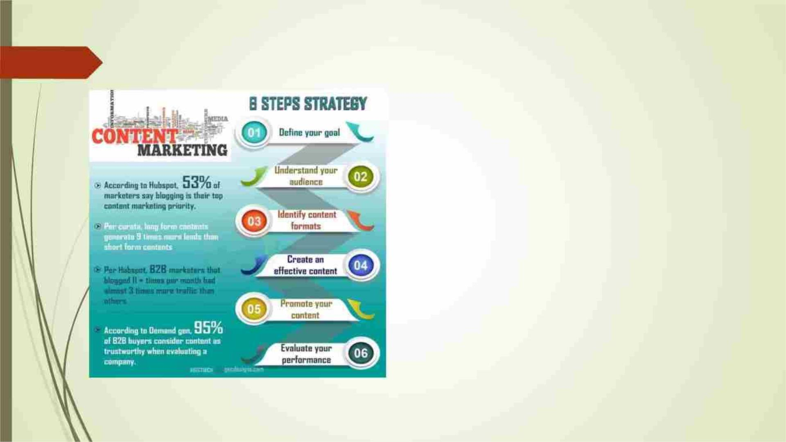
Content Marketing:
 Content marketing is an essential strategy
that allows businesses to reach, engage
and connect with clients through unique
content.
 This generally involves creating exciting
and unique content in the form of blog
posts, videos and infographics. The goal is
to use keywords that appeal to or stick to
the client’s memory, thus motivating them
to consider your product or service.

Slide 18
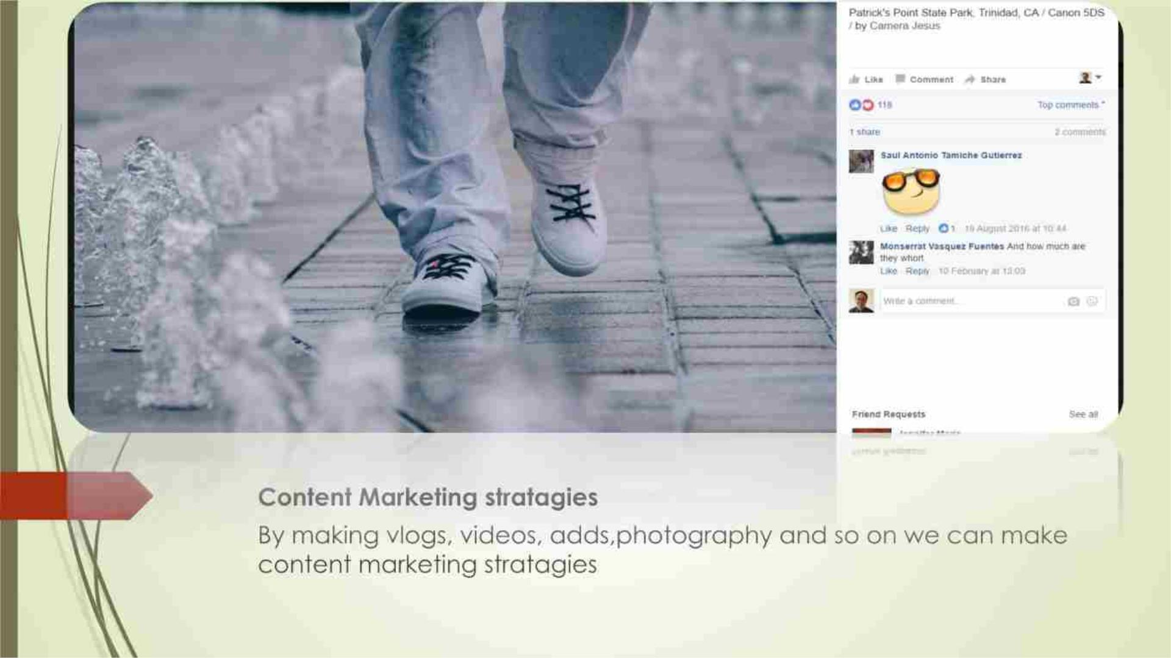

Slide 19
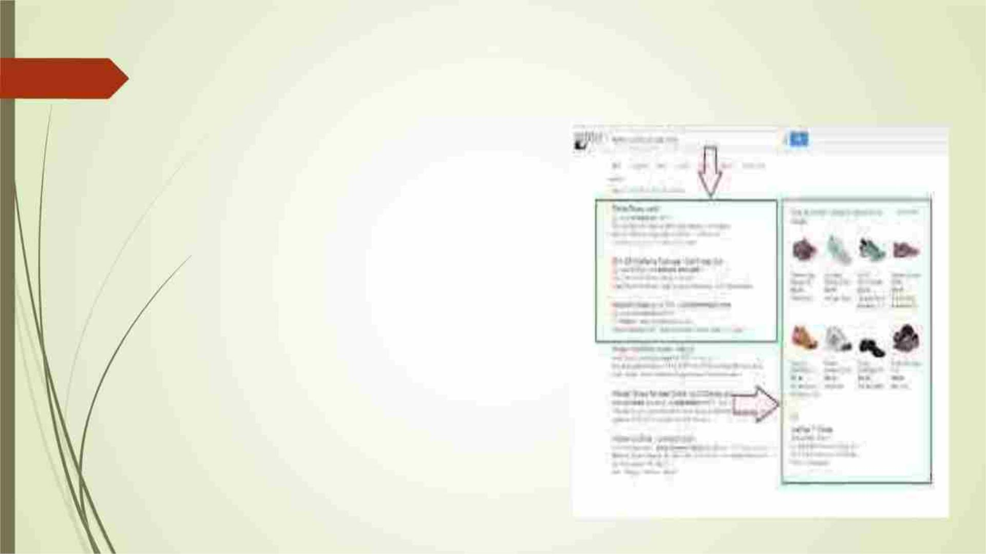
Pay per click advertising:
Pay per click advertising is a very
effective digital marketing strategy. It
involves paid advertisement wherein
the business pays for specific
keywords such that when a person
searches using those keywords, the
particular business site appears.

Slide 20
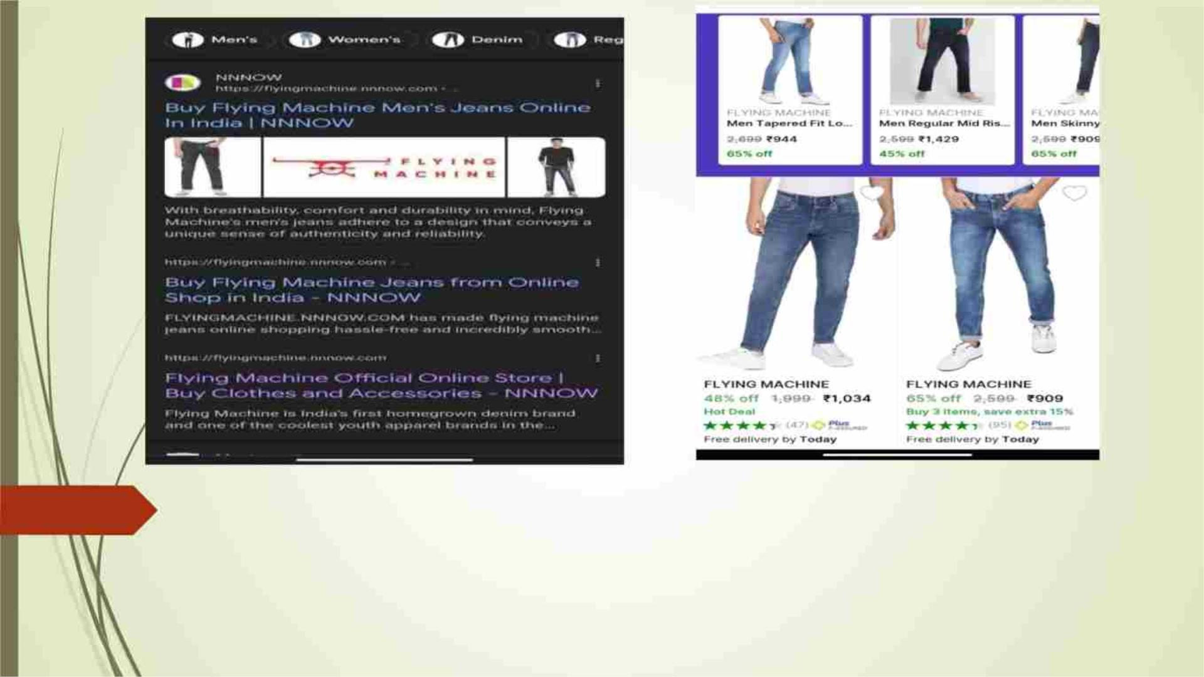
Pay per click:
It involves paid advertisement where in the business pays for specific
keywords such that when a person searches using those keywords, the
particular business site appears.

Slide 21

Video marketing:
Video marketing refers to the strategic usage of digital
marketing videos to increase brand awareness,
conversion rates and company revenues. It does so by
creating unique video content that may be a form of
announcement, behind the scenes video, event-
based video or even a quirky new advertisement.
Before you dive into digital marketing activities, do a
considerable bit of research. Find out what platforms
and channels suit you best. There are too many
variables to discuss at length here. It is always better to
go deep in one or two channels than too thinly
spreading across many channels and losing focus.

Slide 22
THANK YOU

